Slide 1
Milestone Five
Florida Tech IGVC

Slide 2
Milestone 5 Matrix
# | Task | % Complete | Brent | Adam | Chris | Will
1 | LiDAR & Lines | 75% | 0% | 15% | 85% | 0%
2 | Software Integration | 67% | 25% | 25% | 25% | 25%
3 | Software Testing | 50% | 25% | 25% | 25% | 25%
4 | Hardware Integration | 25% | 25% | 25% | 25% | 25%
5 | Motion Planning | 100% | 100% | 0% | 0% | 0%
6 | GUI | 75% | 100% | 0% | 0% | 0%
7 | Startup, Control, Logging | 50% | 10% | 20% | 0% | 70%
8 | Comm. Maintenance | 100% | 10% | 10% | 10% | 70%
9 | IOP | 0% | 0% | 70% | 0% | 30%
10 | Create Poster | 100% | 25% | 25% | 25% | 25%

Slide 3
Navigation & GUI
D* Lite implementation complete
Dimension concerning orientation added
Significant speed and accuracy improvement
Next Steps:
Short sim for testing
Interface for incoming lines and obstacles
Live testing

Slide 4
Line Detection
Line detection on course-like conditions functional
Some issues with half-sun, half-shade images
Able to see obstacles
Polarizing film reduces glare significantly
Next steps
Converting lines into format understandable by motion planner
Working with half and half images
Potentially working on obstacle detection

Slide 5
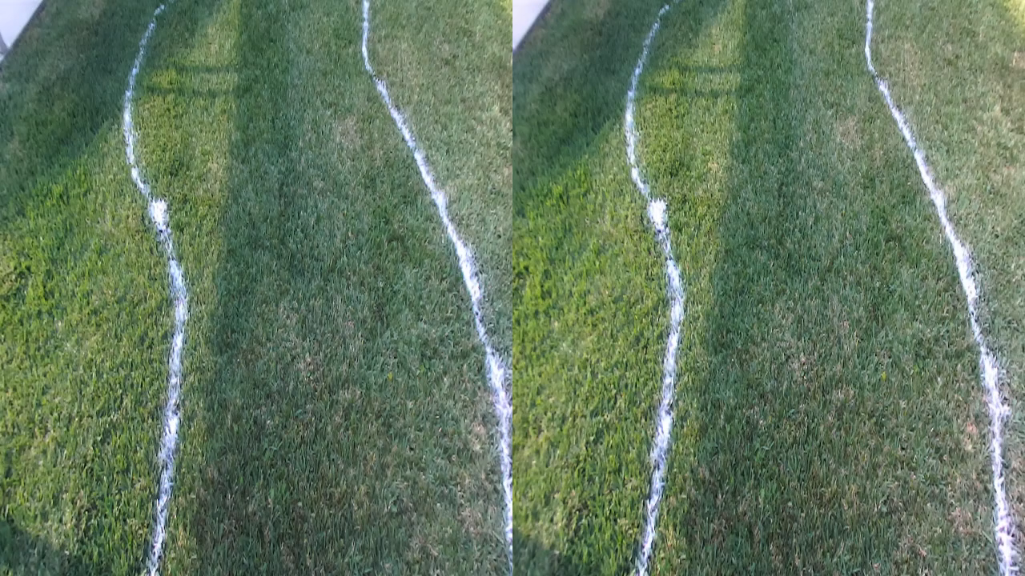

Line Detection Video

Slide 6
Communication
Interface for ROS written
C++ components cleaned up
Next Steps
Get FSU to post their code
Write unit for LiDAR

Slide 7
Integration & Testing
Still developing code
Integration with ROS tested
FSU not allowed to send LiDAR
Robot not shipped
Next steps
Get the robot
Write short sim for motion planner

Slide 8
Position
INS ROS node operational
Robot localization taking encoder values and GPS data
Potentially use triangulation within the motion planner or using the LiDAR to get absolute position
Next steps
FSU is benchmarking the INS
Begin looking at triangulation / trilateration

Slide 9
Milestone 6 Matrix
# | Task | Brent Allard | Adam Hill | Chris Kocsis | Will Nyff.
1 | LiDAR & Lines | 0% | 25% | 75% | 0%
2 | Testing & Integration | 25% | 25% | 25% | 25%
3 | Motion Planning & GUI | 100% | 0% | 0% | 0%
4 | Startup, Control, & IOP | 10% | 60% | 0% | 30%
5 | Comm. Maintenance | 10% | 10% | 10% | 70%
6 | Demo Video | 25% | 25% | 25% | 25%
7 | Documentation | 25% | 25% | 25% | 25%

